Slide 1
SOUTH-SOUTH AND TRIANGULAR COOPERATION HIGHLIGHTS 2018
PARDEV STAFF MEETING
12/12/2018
ANITA AMORIM
Partnerships and Field Support Department (PARDEV)

Slide 2
South-South and triangular cooperation (SSTC) in ILO
2018- 2019
March/2018:
GB paper on SSTC- Future Steps
1 NOV/
GVA & RBA
BAPA+40
NOV
GSSD Expo 2018
RBTC
SSTC REGIONS and ITC
MARCH-ONGOING
2018-2019
INDIA, BRAZIL, CHINA, RUSSIA-FUNDS (ONGOING and NEW)
2019
RESULTS on SSTC and
BAPA +40

Slide 3
GB PAPER- SSTC and Future Steps
SDG and Future of Work -ILO partners
Regional Initiatives and Peer Learning
BAPA+ 40
Awareness , Knowledge and Capacity
SUPPORT ILO STRATEGIC FAMEWORK
F2F and C2C

Slide 4
COLLABORATION WITH ITC TURIN 2018
SSTC Meeting Point (ongoing)
CPLP Decent Work Academy
Disaster Risk Reduction : SSTC perspective
11-15 June
Future of Work in Asia: Care Economy-SSTC
17-19 September
28 May – 01 June
S. Tourism and green
6-8 November
www.southsouthpoint.net

Slide 5
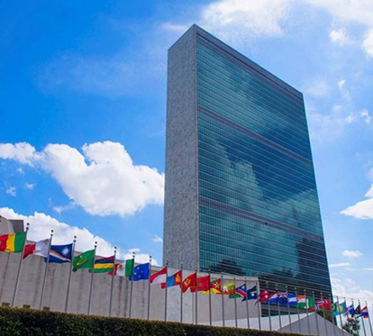
INFORMAL INTER-AGENCY MEETING ON BAPA+40 (1)
UNCTAD, SOUTH CENTRE, ILO
IOM, ITC, ITU, SUN, UNECE, UNEP, UNISDR, Unitaid, UNITAR, UPU, WHO, WIPO, FAO, IFAD, UNDP, UNOSSC, UNCTAD, South Centre, ILO
KEY MESSAGES SSTC for BAPA+40
CO-HOSTS
PARTICIPANTS
OBJECTIVE

Slide 6
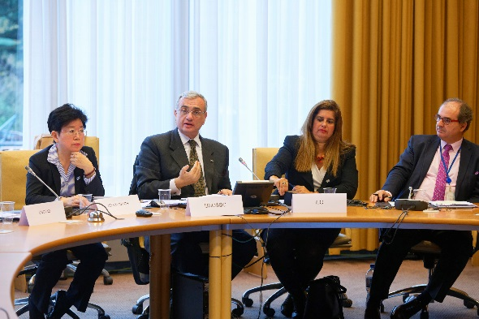
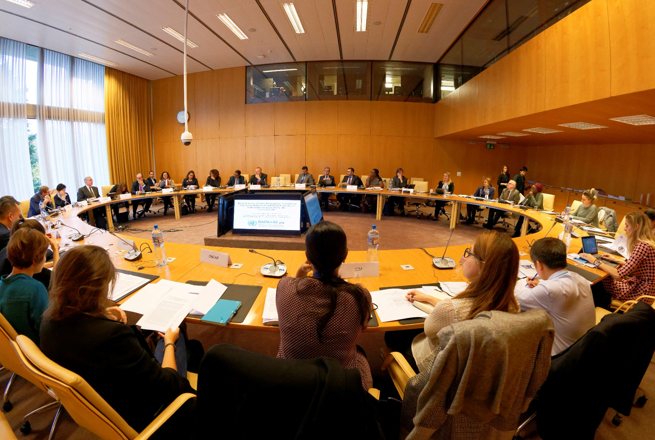
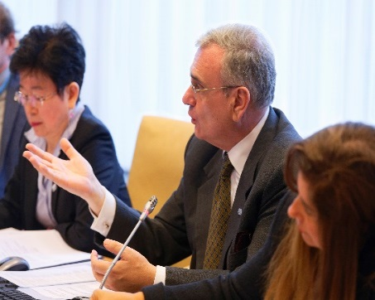
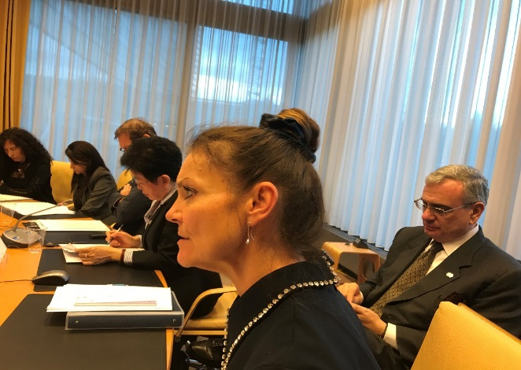
INFORMAL INTER-AGENCY MEETING ON BAPA+40 (2)

Slide 7
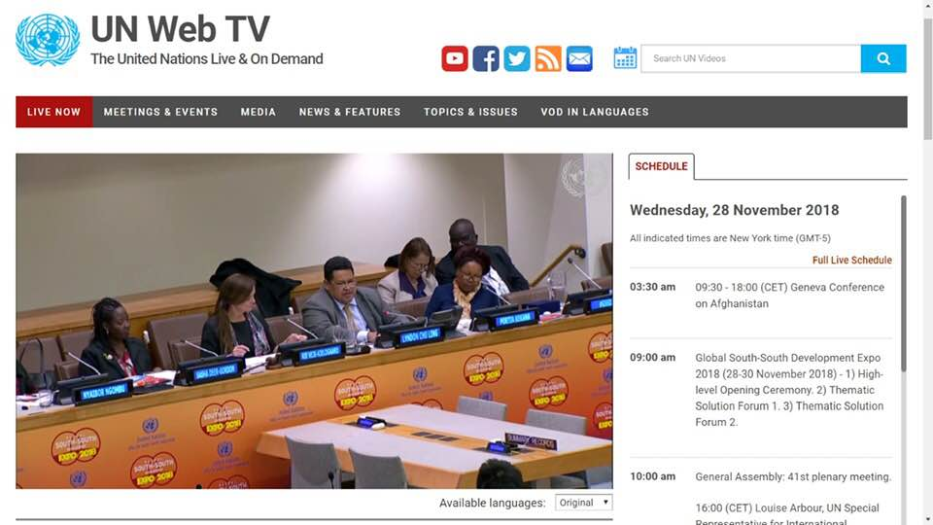
GSSD EXPO 2018 : Flagships and Key Messages

Slide 8
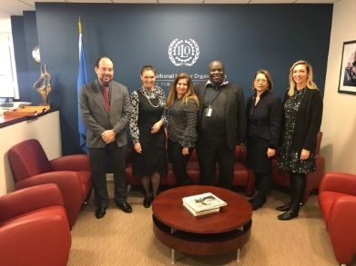
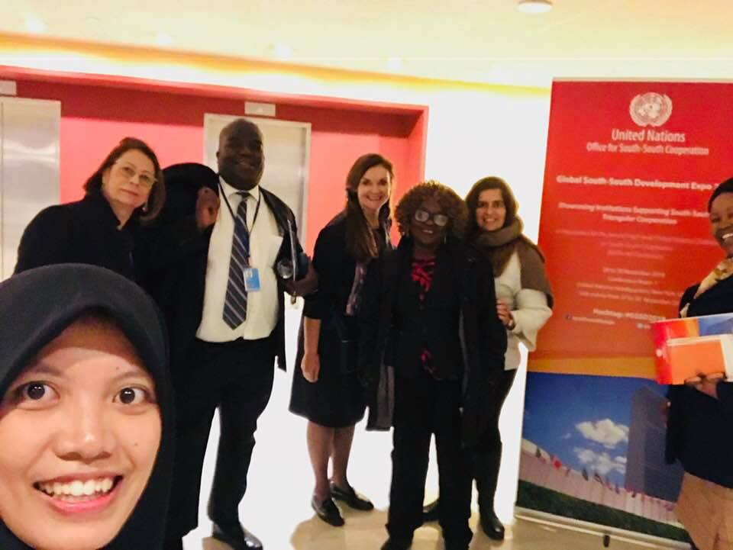
THANK YOU

